Slide 1


CONSUMER GOODS
AD-HOC INSIGHTS
RESUME PROJECT CHALLENGE - 4
Presented by M B Divya

Slide 2
PROJECT OUTLINE
1
About Company
Problem Statement
2
3
Tools & Dataset
Ad-Hoc Requests
4
5
Insights

Slide 3
1
About Company
AtliQ Hardware is one of the leading computer hardware producers in India
and well expanded in other countries.
Internal HDD
Graphic Card
Processors
MotherBoard
Division
Segment
Category
Mouse
Keyboard
Batteries
P & A
Peripherals
Personal Laptop
PC
Accessories
Business Laptop
N & S
Notebook
Gaming Laptop
Desktop
Personal Desktop
Storage
External Solid State Drives
USB Flash Drives
Networking
Wi fi extender

Slide 4

2
Problem Statement
The management observed that they lack sufficient insights to make quick, data-informed decisions. They plan to expand their data analytics team by hiring several junior data analysts.
Tony Sharma, their data analytics director, wanted to hire someone proficient in both technical and soft skills. Therefore, he decided to conduct a SQL challenge to assess both sets of abilities.

Slide 5
3
Tools & Dataset
Tools utilized for this project : MySQL and Power BI
Dataset
gdb0041
Tables
dim_customer
Database
dim_product
fact_gross_price
fact_manufacturing_cost
fact_pre_invoice_deductions
fact_sales_monthly

Slide 6
Ad-Hoc Requests
4

Slide 7
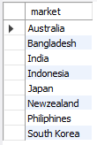

i). Provide the list of markets in which customer "Atliq Exclusive" operates its business in the APAC region.
Insights : Atliq Exclusive operates business in 8 markets across the APAC region.

Slide 8

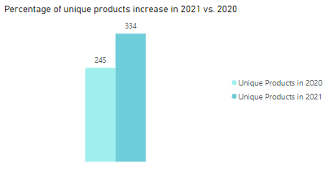
II). What is the percentage of unique product increase in 2021 vs. 2020? The final output contains these fields: “unique_products_2020”, “unique_products_2021”, & “percentage_chg”.
36.33 % ‘Percent Change’
Insights : Production increased by 36.33% compared to the previous year.

Slide 9
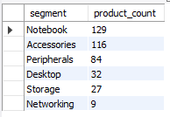
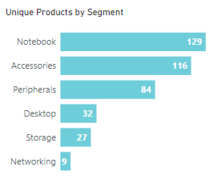
III). Provide a report with all the unique product counts for each segment and sort them in descending order of product counts. The final output contains 2 field: “segment” & “product_count”.
Insights : Among the 6 segments, Notebook lead with 129 unique products, followed by Accessories, Peripherals, Desktops, Storage and Networking.

Slide 10
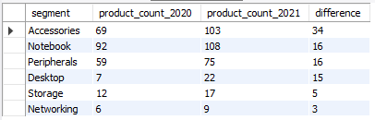
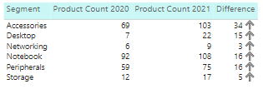
IV). Follow-up: Which segment had the most increase in unique products in 2021 vs 2020? The final output contains these fields: “segment”, “product_count_2020”, “product_count_2021”, & “difference”.
Insights : Accessories was the leading segment, with an increase of 34 unique products in 2021 compared to 2020.

Slide 11


V). Get the products that have the highest and lowest manufacturing costs. The final output should contain these fields: “product_code”, “product” & “manufacturing_cost”.
Insights: The AQ HOME Allin1 Gen 2 has the highest manufacturing cost, while the AQ Master Wired x1 Ms has the lowest among all the products.

Slide 12
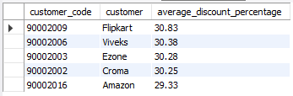
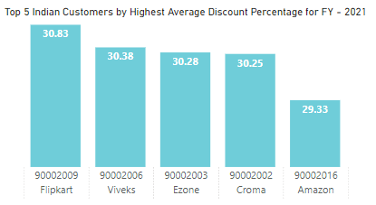
VI). Generate a report which contains the top 5 customers who received an average high pre_invoice_discount_pct for the fiscal year 2021 and in the Indian market. The final output contains these fields: “customer_code”, “customer” & “average_discount_percentage”.
Insights : Flipkart was the top customer in FY-2021 with an average discount percentage of 30.83%, followed by Viveks, Ezone, Croma, and Amazon.

Slide 13
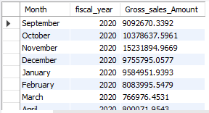
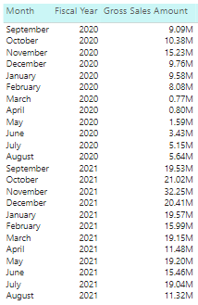
VII). Get the complete report of the Gross sales amount for the customer “Atliq Exclusive” for each month. This analysis helps to get an idea of low and high-performing months and take strategic decisions. The final report contains these columns: “Month”, “Year” & “Gross sales Amount”.
Insights : In November month, noticed high sales amount compared to other months for both FY-20 and 21.

Slide 14
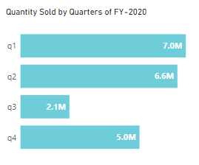

VIII). In which quarter of 2020, got the maximum total_sold_quantity? The final output contains these fields sorted by the total_sold_quantity: “Quarter” & “total_sold_quantity”.
Insights : In Quarter-1, noticed highest sold quantity later gradually decreased in FY-2020.

Slide 15
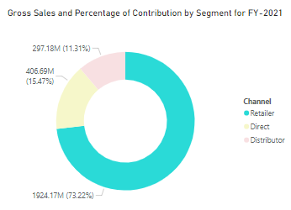

IX). Which channel helped to bring more gross sales in the fiscal year 2021 and the percentage of contribution ? The final output contain these fields: “channel”, “gross_sales_mln”, “percentage”.
Insights : The retailer channel generated the highest gross sales, contributing 73.22% in FY 2021.

Slide 16
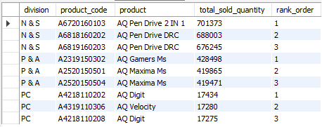
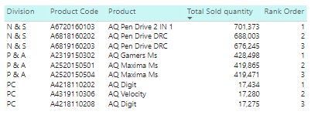
X). Get the top 3 products in each division that have a high total_sold_quantity in the fiscal year 2021 ? The final output contains these fields: “division”, “product_code”, “product” “total_sold_quantity”, “rank_order”.
Insights : For FY - 2021
* The AQ Pen Drive 2 IN 1 was the top product in the N & S Division.
* The AQ Gamers Ms was the top product in the P & A Division.
* The AQ Digit(A4218110202) was the top product in the PC Division.

Slide 17
Thank You!

